Slide 1
IMG Work plan:
Phase 1: Short Sequences
VQEG Plenary Meeting
Shenzhen, 14-18 October 2019

Slide 2
Immersive Media Group
Context
Mission: Quality assessment of immersive media, including virtual reality, augmented reality, plenoptic, stereoscopic 3DTV, multiview…
Goals: Baseline quality assessment of immersive systems
Datasets of immersive media content
Subjective test methods, QoE guidelines, presentation requirements, etc.
Technologies:
360-degree content / Virtual Reality
Augmented/Mixed reality
3D, FVV, multiview technologies, including full parallax
Light field processing also called plenoptic
Email reflector: img@vqeg.org

Slide 3
Immersive Media Group
Context
Discussions, contributions, and presentations in the f2f meetings are more than welcome covering any immersive media technology.
In March 2018 (meeting in Madrid) it was decided to:
Push joint work.
Focus on some more specific uses cases for the joint work
Monthly audio calls
Identified uses cases of interest for the participant labs: https://docs.google.com/spreadsheets/d/1FgnRXjiU4td_KwkeKwGvy652nCDBvrAvkSug6HZivZ4/edit#gid=0
Decided in July 2018 to consider the use case of subjective quality evaluation of 360-degree video for joint work.

Slide 4
Immersive Media Group
Quality assessment for 360˚ content
Working on a test plan: https://docs.google.com/document/d/18L_Q7vyzEssoAzbRsTKBTtMrwfjISMf0HUGofPqOOJI/edit?usp=sharing
Specific proposals for the test plan on evaluating quality for:
Short sequences: Length of sequences, ACR vs DCR, Influence of HW, typical artifact (coding, projections, stitching, etc.)…
Long sequences: immersiveness, presence, simulator sickness, etc.
Collaboration VQEG-IMG and ITU-T SG12 Q13:
Main points:
Recommendation G.QOE-VR: QoE key factors of VR
Collaboration through individual contributions from VQEG-IMG members and ad-hoc group.
Recommendation P.360-VR: subjective evaluation of 360-degree video
Collaboration aligned with the joint work on the VQEG-IMG test plan.

Slide 5
Phase 1. Short Sequences
Contribution to P.360-VR
Global target of the test plan
Design and execute a cross-lab test where we can assess and validate subjective evaluation methodology for 360 VR video
Contribute to the standardization of such methodology under ITU-T P.360-VR (Q13/12)
Generate a dataset of subjectively assessed content for future research
What Phase 1 covers
Assessment of short sequences (<=30s), in the spirit of ITU-R BT.500, ITU-T P.910, etc.
Assessment of video quality and simulator sickness.
What is not covered in Phase 1 (will be in Phase 2)
Assessment of long sequences (several minutes).
Assessment of presence.

Slide 6
Phase 1. Short Sequences
Current status
Identified 8 (+4) SRCs and 10 HRCs for the test
Available at raw format (uncompressed)
Free to use for research
Developed, tested and validated subjective assessment software (”Miro360”)
For desktop (HTC and Oculus) and mobile (GearVR and Daydream)
Conducted a pre-test to assess methodology and test cases
9 participant labs
Some conclusions (Monday 14th session):
Remove some SRCs: Segovia, Thieves. Fix some PVSs which are broken
Miro360 changes/fixes: initial orientation and selection of playlists
Improve training session to include more qualities (especially non-uniform coding)
Improve pre- and post-session questionnaires

Slide 7
Video Quality
Contribution to P.360-VR
Recommend:
Implementation of ACR and DCR methodologies for 360 videos
Sequence duration
Study of influence factors:
HMD
Source content characteristics
Uniform vs non-uniform artifacts

Slide 8
Simulator Sickness
Contribution to P.360-VR
Recommend:
One multi-item questionnaire (SSQ or derivation from it), and/or
One single-question item
Write some guidelines about:
When/how to assess simulator sickness
When can you use a single-question vs. full questionnaire
How to process the results / what to do with them

Slide 9
Test plan ingredients
SRCs, PVSs, etc
~12 Raw sources
4K (some available in 8K), equirectangular, monoscopic (some available in stereo), static camera.
10, 20 and 30 second cuts
8 of them already in pre-test (Dojo Zentrum, Segovia, Flamenco, Cheer Leading, Brazil Music, Thieves At Lake, Vaude and Luther). 4 for backup.
10 HRCs (including Hidden Reference), HEVC, fixed QP
6 homogeneous QPs: 15 (HR), 22, 27*, 32, 37*, 42
4 non-homogeneous QPs (tiles)
*Removed for 8 and 6 HRC test
**Removed for 6 HRC test
#Tiles | Transition | ROI | QPs
8x5** | Smooth | 90^{O} | 42 | 37 |  | 32 |  | 22 | 22 | 32 |  | 37 |  | 42
6x3 | Smooth | 120^{O} | 42 |  | 32 |  | 22 |  | 22 |  | 32 |  | 42
8x5** | Abrupt | 180^{O} | 42 | 42 |  | 22 |  | 22 | 22 | 22 |  | 42 |  | 42
6x3 | Abrupt | 120^{O} | 37 |  | 37 |  | 22 |  | 22 |  | 37 |  | 37

Slide 10
Source analysis
SI, TI, saliency
Source | SI | TI | Saliency
BrazilMusic | 39.0 | 3.8
Cheerleading | 37.7 | 1.7
DojoZentrum | 61.6 | 4.8
Segovia | 72.1 | 6.8
Flamenco | 64.8 | 7.9
ThievesAtLake | 47.4 | 1.0
Vaude | 60.3 | 2.7
Luther | 33.2 | 2.0

Slide 11
HRC analysis
PSNR, VMAF

Slide 12
Test session structure
Measuring methodology
Each subject tests the same PVSs under two different conditions
Use within-subject statistics for better statistical power
Each condition is tested in one active period
After each 15-20 min of active session, we should have a rest period of 5 min.
Just before and after each active period, score simulator sickness
Intro
Test Condition A
Rest (5 min)
Test Condition B
Wrap-up
Instructions in written form
Visual acuity & color tests
Training session
Doubts/Questions

Slide 13
Simulator Sickness
In each SS measurement, subjects score both:
First, a single question (1-5 scale): always the same (A or B), randomly assigned
Second, SSQ [Kennedy 1993]
A. Are you feeling any sickness or discomfort now? Check the appropriate sentence
B. How is your level of dizziness or nausea?
No problem | No perceptible effect, natural feeling
Light effects | Slight discomfort, but no sickness
Uncomfortable | Moderate discomfort, but tolerable for a while
Unpleasant | Strong discomfort or sickness, but can continue the test
Unbearable | Strong discomfort or sickness, and want to stop test
Very dizzy
Dizzy
Slightly dizzy
Not dizzy
Absolutely not dizzy

Slide 14
Simulator Sickness Questionnaire
Kennedy 1993
Circle how much each symptom below is affecting you right now
None
Slight
Moderate
Severe
General discomfort
Fatigue
Headache
Eye strain
Difficulty focusing
Increased salivation
Sweating
Nausea
Difficulty concentrating
Fullness of head
Blurred vision
Dizzy (eyes open)
Dizzy (eyes closed)
Vertigo
Stomach awareness
Burping

Slide 15
Test Conditions
Research Questions
Video Quality
Test methodology
ACR vs DCR [B?]
Test duration
10s vs 20s [W]
20s vs 30s [W]
Test setup
HTC Vive vs Samsung Gear VR [W]
Scoring app vs “Saying out lout” [?]
Simulator sickness
Short vs long questionnaire [W]
Short-SSQ vs Vertigo questionnaire [B]
Content factors
Low vs high camera motion [W]
Monoscopic vs stereoscopic [W]
With vs without audio [W]
[W] – Within-subject design
[B] – Between-subject design

Slide 16
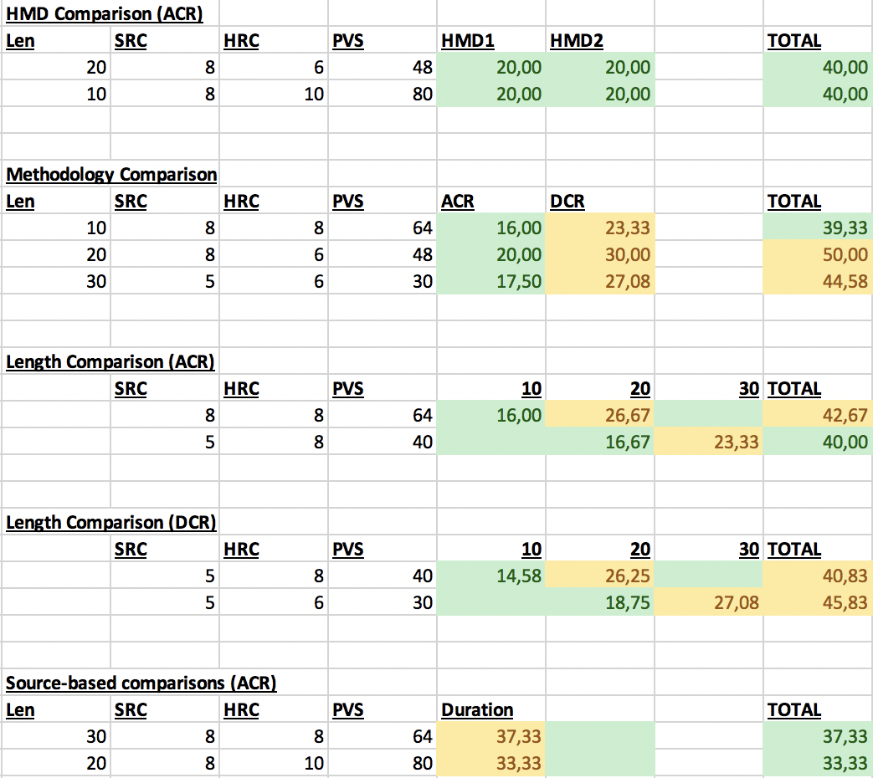
Test Conditions
Within-subject comparison
HMD comparison
Apply to test-setup conditions
Pick one duration
Methodology comparison
Could be removed → use between-subject comparison from “length comparison” sessions
Length comparison
Most critical one
Is 30s DCR really an option?
Source-based comparisons
SRCs include all conditions
Pick duration depending on condition

Slide 17
Test Conditions
Within-subject Design
Number of subjects
#PVS | #Subjects (A) | #Subjects (B)
30 | 18 | 26
48 | 20 | 28
64 | 20 | 30
80 | 21 | 31
Expected sample STD = 0.9
From previous 360VR tests
Desired power = 0.8
Desired MOS difference = 1
NC: number of comparisons (for N PVSs)
Case A: compare the same PVS in two different conditions (e.g. 10s vs 20s)
NC = N
Case B: all possible comparisons of N PVSs
NC = N*(N-1)/2
Between-subject Design
#PVS | #Subjects (A) | #Subjects (B)
30 | 29 | 40
48 | 31 | 44
64 | 32 | 46
80 | 33 | 48
https://slhck.shinyapps.io/number-of-subjects/

Slide 18
Participant labs
And potential test conditions
U. Politécnica de Madrid
Nokia Bell Labs
T.U. Ilmenau
U. Roma Tre
RISE
U. Surrey
Wuhan U.
U. Ghent
CWI
Tentative: ARM, AGH
ACR: 10s vs 20s
ACR: 20s vs 30s
DCR: 10s vs 20s
DCR: 20s vs 30s
Vive vs Gear? (ACR 20s)*
Vive vs Vive Pro? (ACR 20s)*
Oculus vs Vive? (ACR 20s)*
With vs without audio (ACR 20s)
Scoring interface vs voice (ACR 20s)
Back-up conditions (if new labs are available)
ACR: 10s vs 30s
DCR: 10s vs 30s
*Pairs of HMD to compare yet to be decided

Slide 19
Test conditions for future research
ACR vs DCR: 20s
ACR vs DCR: 10s
Low vs high camera motion (ACR 20s)
Low vs high camera motion (ACR 30s)
Monoscopic vs stereo (ACR 20s)
4K vs 6K resolution (ACR 20s)
With/without cables
… (anything missing?)

Slide 20
Data Analysis
Potential tools
Hypothesis test (Student-t, ANOVA)
Validate the influence on the results of each tested condition (in pairs)
Conditioned to HRC type (homogeneous vs heterogeneous degradations)
Quantitative analysis of the results
MOS and SOS computation
Cross-lab correlations
Factor Analysis of SSQ results (EFA/CFA)
Analysis of head orientation
How?
Others?
But…
Who wants to contribute?
Support from SAM?

Slide 21
Exploitation of results
Proposal
Contribution for ITU-T P.360-VR
One journal paper
With the conclusions of the study
Authors: people from each participant lab which have contributed significantly to the work
Editors/writers (first authors): Jesús Gutiérrez & Pablo Pérez
Public data set
All test result files (raw data)
All PVSs (if possible) – Where? CDVL?
Linked to the journal paper (for citation)
Rule: each participant lab, before starting the test, must
Agree on the publication of the data set
Propose the names of authors for the paper, and their expected contributions

Slide 22
Test plan
Phase 1 schedule
Date | Item
October | Modifications to test interface, HRCs, SRCs, etc.
05/11/19 | IMG audio call. Test kick-off.
Nov-Dec | Execution of tests in all labs.
09/01/20 | IMG audio call. Recap of test execution. Plan result analysis.
Q1 2020 | Analysis of results. Paper draft.
Next F2F | Presentation of results to VQEG and ITU-T Q13/12 Discussion of next steps (phase 2).
Q2 2020 | Submission of journal article.

Slide 23
Test Plan Phase 1
Decision list
Baseline test methodology
Use of ACR and DCR
Simulator Sickness protocol and questions
Session structure and duration
Use of Miro360 app interface
Baseline PVSs
8 reference SRCs (same as pre-test)
5 of them for longer tests (which ones?)
List of HRCs and their subsets
Additional PVSs
Sources for high-motion content
Sources for stereoscopic content
Test conditions
Select which ones will be tested
Assignment to labs
Minimum number of subjects
Analysis of results
How and who
Exploitation of results
Journal paper
Author list
Public data set (including raw data)
Schedule

Slide 24
Decisions &
action points

Slide 25
Decisions (1/5)
Summary of agreed parts of the test plan
Agreed on baseline test methodology
Use of ACR and DCR
Simulator Sickness protocol and questions
Session structure and duration
Use of Miro360 app interface
Agreed on baseline SRCs
There will be 8 SRCs
5 of them will be used for for longer tests
Based on the ones from pre-test
Remove Segovia and Thieves
Maybe remove others with stitching artifacts
Agreed on list of HRCs and their subsets
No additional PVSs for specific test cases
Agreed on test conditions
Select which ones will be tested (see next slides)
Each lab will test one test condition
Minimum number of subjects: 30 per lab
ACR methodology will look for compression artifacts
Explained in the training part so that we can search for more values equal to 5
Some modifications are needed from pre-test (see next slides)
Agreed on exploitation of results
Journal paper and public data set
See following slides for details
Agreed on rough schedule (tentative)

Slide 26
Decisions (2/5)
Summary of agreed parts of the test plan
Agreed on main test conditions
ACR: 10s vs 20s
ACR: 20s vs 30s
DCR: 10s vs 20s
DCR: 20s vs 30s
HMD vs HMD (ACR 20s)
HMD vs HMD (ACR 20s)
HMD vs HMD (ACR 20s)
With vs without audio (ACR 20s)
Scoring interface vs voice (ACR 20s)
Pending decision: which pairs of HMDs to compare
Agreed on extra test conditions if new labs can join
ACR: 10s vs 30s
DCR: 10s vs 30s

Slide 27
Decisions (3/5)
Conclusions of the pre-test discussion
Remove some SRCs: Segovia, Thieves.
Fix some PVSs which are broken
Miro360 changes/fixes: initial orientation and selection of playlists
Improve training session to
Include more qualities (especially non-uniform coding)
Train people better on the defects that they have to assess
Improve pre- and post-session questionnaires

Slide 28
Decisions (4/5)
Exploitation of results
We will write a contribution for ITU-T P.360-VR
Target date: end of March 2020 (before next SG12 meeting in April 202)
One journal paper
With the conclusions of the study
Authors: people from each participant lab which have contributed significantly to the work
Editors/writers (first authors): Jesús Gutiérrez & Pablo Pérez
Public data set
All test result files (raw data) and all PVSs
Linked to the journal paper (for citation)
Rule: each participant lab, before starting the test, must
Agree on the publication of the data set
Propose the names of authors for the paper, and their expected contributions

Slide 29
Decisions (5/5)
Tentative schedule
Finish preparations/modifications during October
Try to kick-off tests by the beginning of November
Target date to have tests ready: end of December
Hard deadline: end of January
Contribution to ITU-T ready by end of March
Next SG12 meeting in April 15th -24th

Slide 30
Action items
Action items
Fixes in Miro360 app (NOK, UPM)
Final selection of SRCs (IMG*)
Finish analysis/characterization of content
Selection of HMD comparisons (IMG)
Check the availability of Oculus sending hardware to the labs for testing (FB)
Assignment of test conditions to labs (IMG)
Confirm possible new labs (AGH, ARM)
Data analysis:
Clearly establish hypothesis / expected behaviors (IMG)
Establish data analysis procedure (?)
Improve test methodology:
Pre-session questionnaire (RISE)
Training session (IMG)
Post-session questionnaire (NOK, RISE, AGH)
*IMG = IMG chairs

